Slide 1
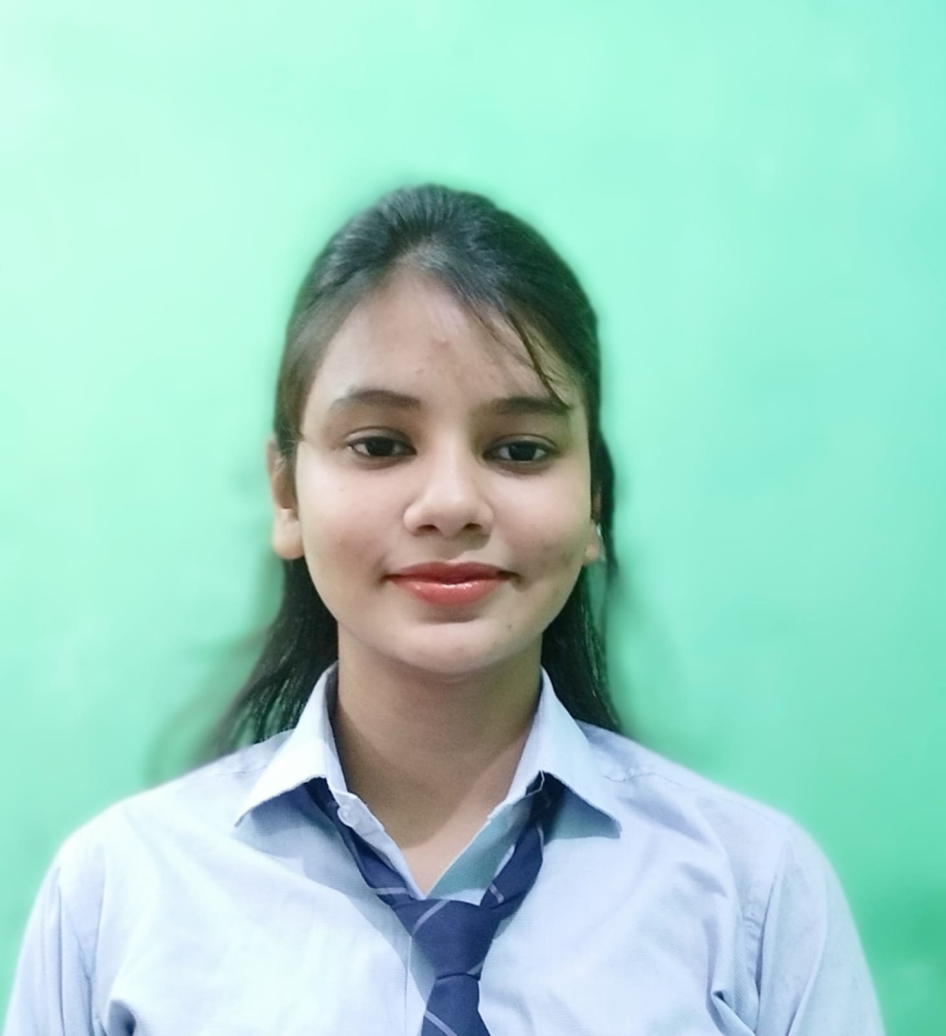



Riya Singh
Analyst/Software Engineer
Bachelor of Technology in
Electrical Engineering :
2018- 2022
Skills
Java 8 /J2EE | Java Basics, OOPS, Generics, Collections, Arrays, Loops, Lambda Exp, Stream API Junit, Mockito
Spring core | IOC & Dependency Injection, Autowire
Spring REST | REST controllers, Implementation of GET, POST, PUT & DELETE, Bean Validation & Exception Handling, Testing Services, Controller & Repository layer
Spring Data JPA | Implement DAO layer using spring Data repositories
Spring Boot Microservices | Spring Boot Starters, annotations, Swagger API documents
Spring Cloud | Eureka, Netflix Hystrix, Netflix Config Server, Netflix Zuul
React | Components, Hooks, Event handling
Database | MongoDB No Sql Basics, PostgreSQL Basics
UI Tech | HTML 5 & CSS 3,JavaScript, ES6
Tools | Git, Postman, Maven, Eclipse IDE, Spring Boot
Add On skills | Communications, Team management. Peer learning
Bangalore
riya.s.singh@capgemini.com
+91 8910272822
A4
Full Stack Developer
Hands on experience in creating microservices with Springboot, Spring Security with JWT, Spring Cloud API Gateway, Eureka server, Hystrix.
Hands on experience in implementing polyglot architecture with spring boot .
Experience in creating documentation with Java docs and swagger and in unit testing using Junit, Mockito.
Java Microservice Development knowledge using Spring boot and spring cloud framework on an beginner level.
Hands on experience in developing web pages using HTML5, CSS3, ReactJS.
Hands on experience in implementing MongoDB & PostgreSQL.
Flight Booking System
Completed end to end case study of Flight Booking Application along with JWT authentication, Swagger and Mockito,MongoDB. ReactJS is used for user interface.
Bus Booking Application
Completed end to end case study of Bus Booking Application along with Monolithic architecture, made using Spring Boot, Junit, PostgreSQL. React JS is used for user interface with one to many relationship.
Check out my work on GitHub & Video Profile

